Slide 1
E1 (PVT) to E2 (PV2) PROMOTION WORKSHEET (6/17/2022)
Cadet Name (last, first): ______________________________ Company: _____________
Task: Date Completed: Certified By (rank & name):
Recite the JROTC “Mission” ______________ ______________________
Recite the “Purpose” of JROTC ______________ ______________________
Recite the “Key to Success” in JROTC ______________ ______________________
Recite the “JROTC Creed” ______________ ______________________
Score 100% on Rank Test ______________ ______________________
BN Chain of Command Test ______________ ______________________
Perform Basic Drill Movements ______________ ______________________
75% or higher on Inspection ______________ ______________________
______________ ______________________
PSG: _____________________ 1SG: ____________________ CDR: ___________________
SAI / AI Verifies or Waives the Following: _________________________________
Grade of 75 % or Higher in JROTC
No detention or suspensions in 9 Week Period
No Missed Uniform Wears in 9 Week Period
No More than 1 Unexcused Absence in 9 Week Period
Teacher’s Endorsement Received with Favorable Recommendations

Slide 2
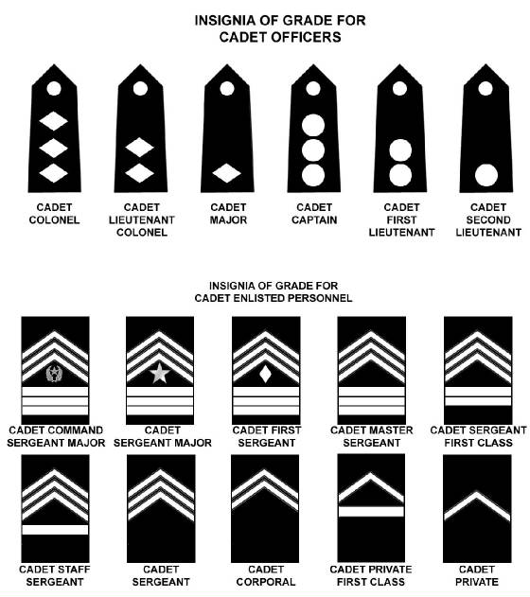
JROTC Creed
I am an Army Junior ROTC Cadet.
I will always conduct myself to bring credit to my family, country, school and the Corps of Cadets.
I am loyal and patriotic.
I am the future of the United States of America.
I do not lie, cheat or steal and will always be accountable for my actions and deeds.
I will always practice good citizenship and patriotism.
I will work hard to improve my mind and strengthen my body.
I will seek the mantle of leadership and stand prepared to uphold the Constitution and the American way of life.
May God grant me the strength to always live by this creed.
Army JROTC
JROTC MISSION: “To motivate young people to be better citizens.”
ARMY MISSION: “To protect, defend and uphold the Constitution of the United States of American from all enemies, foreign and Domestic”
PURPOSE: “To help cadets graduate from high school.”
KEY TO SUCCESS: “Teamwork”
JROTC Cadet Chain of Command
Battalion Commander: ________________________________________________
Battalion Executive Officer: ________________________________________________
Battalion Command Sergeant Major: _______________________________________________
_
Personnel Officer, S1: ________________________________________________
Security Officer, S2: ________________________________________________
Operations & Training Officer, S3: ________________________________________________
Logistics Officer, S4: ________________________________________________
Public Affairs Officer, S5: ________________________________________________
Information Technology Officer, S6 ________________________________________________
Rifle Marksmanship Officer ________________________________________________
Company Commander: ________________________________________________
Company First Sergeant: ________________________________________________

