Slide 1
E3 (PFC) to E4 (CPL) PROMOTION WORKSHEET (as of 6/17/2022)
Cadet Name (last, first): ______________________________ Company: _____________
Task: Date Completed: Certified By (rank & name):
Recertify E1 thru E3 Knowledge ______________ ______________________
Define Leadership ______________ ______________________
Three General Orders ______________ ______________________
Attend 1 BN Activity (since last promotion) ______________ ______________________
Properly Instruct Stationary Drill ______________ ______________________
Uniform Knowledge ______________ ______________________
Score 85% or higher on inspection (slp)_____________ ______________________
Name & define 5 Leadership Principles _____________ ______________________
Recommend for Promotion:
1SG: ____________________ CDR: ___________________
SAI / AI Verifies or Waives the Following: _________________________________
Grade of 75 % or Higher in JROTC
No ISS/OSS in 9 Week Period
No Missed Inspections in 9 Week Period
No More than 1 Unexcused Absences in 9 Week Period

Slide 2
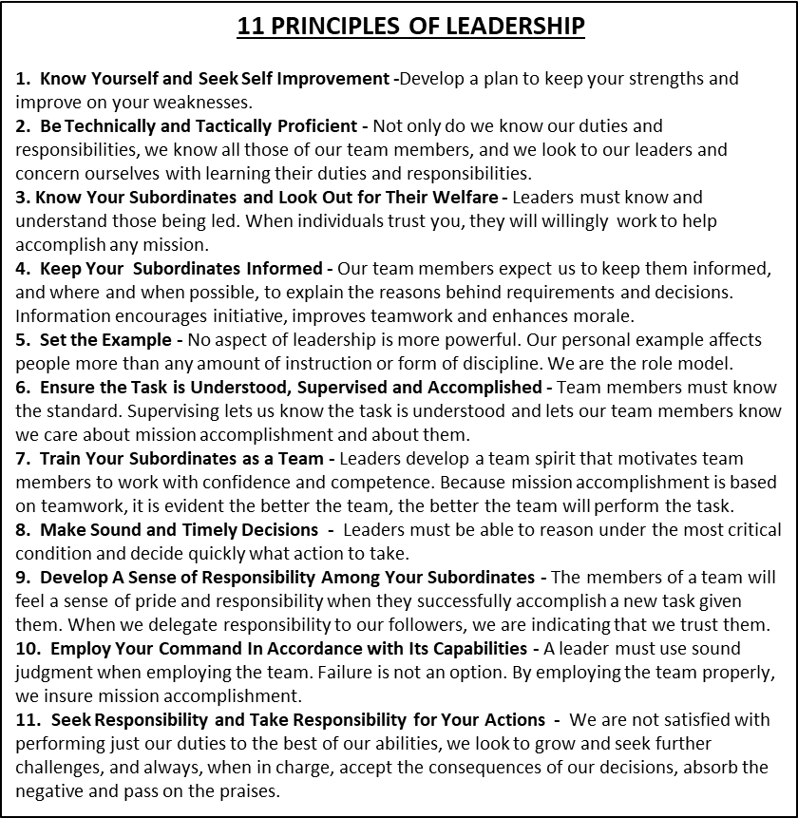
Your three general orders:
1. I will guard everything within the limits of my post and quit my post only when properly relieved
2. I will obey all my special orders and perform all my duties in a military manner
3. I will report all violations of my special orders, emergencies, and anything not covered in my instructions to the commander of the relief
UNIFORM
WA-HI Battalion Crest
Shock of Wheat – Main crop of Walla Walla
Crossed Sabre and Rifle – Military Presence in Walla Walla
Crossed Peace Pipe and Tomahawk – Tribute to Native
Americans
Cross – Whitman mission
Jagged Line – Blue Mountains
Wavy Line – Mill Creek
Blue Devil – Wa-Hi Mascot
Blue and White – Wa-Hi Colors
Torch – JROTC Torch of Knowledge
CORDS
Blue and White (Right Arm) – Member of any Special Team
Red (Left arm) – Drill Team
Gold (Left Arm) – Rifle Team
White (Left Arm) – Color Guard
Black (Left Arm) – PT Team
Leadership: The process of influencing others to accomplish a mission by providing purpose, direction and motivation.

